Slide 1
PRIDE OF BEING मराठी

Slide 2
Maharashtrian Today
01
No Clear Marathi Identity
Maharashtra has a rich cultural history with progressive leaders in the past. But no contemporary leaders represent Maharashtra despite the significance of the state
02
Fragmenting Forces are making Marathi’s feel Adrift
Is grappling with a fragmented Identity
Divisive political forces & Caste divisions. Conflict between value systems - perception that we are self content and happy without progress
03
Marathi Content
Marathi Cinema is progressive, intellectual and successful at the box office at the same time
However that has not translated into TV content
The content of TV is still not as progressive as Marathi Cinema and is still stereotypical

Slide 3
We believe that Entertainment fortifies Identity
Sony मराठी is here to make
Being Marathi the pride of India

Slide 4
Presenting Sony मराठी
Breaking barriers and bringing Marathi Hearts together
Breaking Stereotypes and offering bold and courageous content

Slide 5
Sony मराठी Content Values
Universal Values
Integrity, Harmony in relationships, Balance work and life
Inspirational Protagonists
Protagonists with inner strength and resolve
Courageous and non stereotypical who break out of comfort zone and go beyond, without losing roots
Relatable relationships
Sophisticated and good looking yet grounded in the Marathi Culture
Family Drama
Family Entertainment brings people together (positive stories)

Slide 6
Sony मराठी The Brand Promise
HUMOR
SOPHISTICATED
COURAGEOUS
ORIGINAL
RESPECT FOR
AUDIENCE
BREAKING
STEREOTYPES
COME
TOGETHER
YOUNG
THOUGHT
LEADERSHIP
MAGNETISM

Slide 7
What differentiates us
01
02
FROM COMPETITION
Break Stereotypes
Good Quality of Shows
03
04
Positive Content
Best Curated content
by industry stalwarts

Slide 8
CONTENT BOUQUET

Slide 9
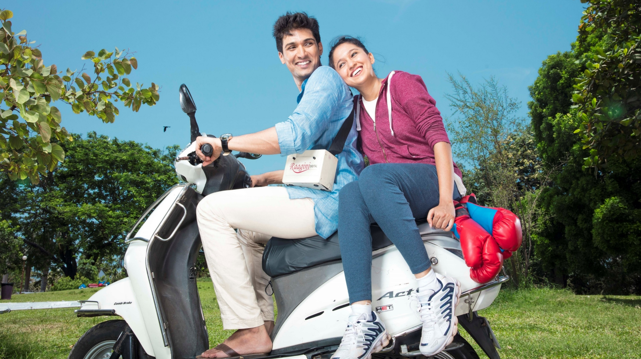
सारे तुझ्याचसाठी
Saarey Tujyach Saathi

Slide 10
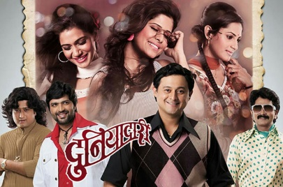
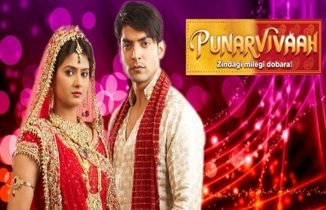
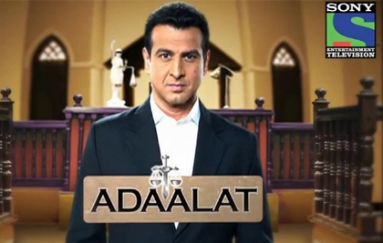
सारे तुझ्याचसाठी Saarey Tujyach Saathi
When Brute & Finesse collide… there is scope for a love story. A Boxer and a Classical Singer are tangled together in an arranged marriage by their families. Their diverse personalities make living under one roof a daily task for both.
Writer
Chinmay Mandlekar
Writer
Manish Khandelwal
Writer
Shweta Pendse
Harshad Atkari
Creds- Maharashtra times most liked face
Gautami Deshpande
Creds- Fresh face on Marathi TV

Slide 11
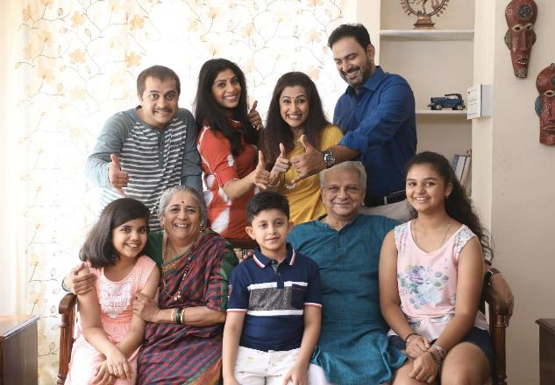
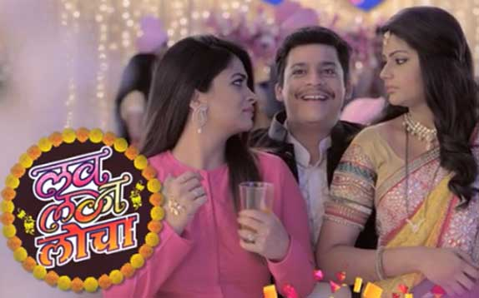
ह.म. बने तु.म. बने H.M.Bane, T.M.Bane
The story revolves around three women (wives and mother in law) with different personalities and their conflicting point of views. The different POVs stem from their different lifestyles and roles within the family.
The portrayal of each women will break stereotypes of Working women, Housewife and Mother in law. It is a fresh and delightful take on daily nok-jhok of 2 daughter-in-laws and a non-controlling mother in law who continuously strives to balances the opposites.
Aditi Sarangdhar, Rani Gunaji, Pradeep Velankar, Ujwala Jog, Sachin Deshpande, Ajinkya Joshi
Creds- Renowned faces of Marathi TV & Films
Writer
Amol Patil
Writer
Sachin Gokhale

Slide 12
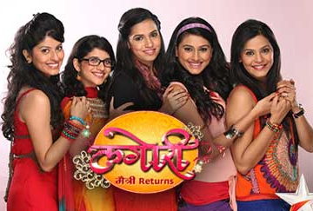
हृदयात वाजे Something Hrudhyat waje something
A teenage love story of a talented dancer boy from a simple middle class joint family who goes through a change in lifestyle and finances, after he wins a dance reality show. The story advances with love triangle between Yash (protagonist), Tina(Flamboyant girl that yash falls for), Kalyani (yash’s childhood friend) simple secret sins of the family who is experiencing fame and financial freedom.
Sneha Chavhan
Creds- Fresh face on Marathi TV
Nikhil Damle
Creds- Fresh face on Marathi TV
Writer
Ganesh Pandit
Writer
Shripad Joshi
Director
Shailesh Dere

Slide 13
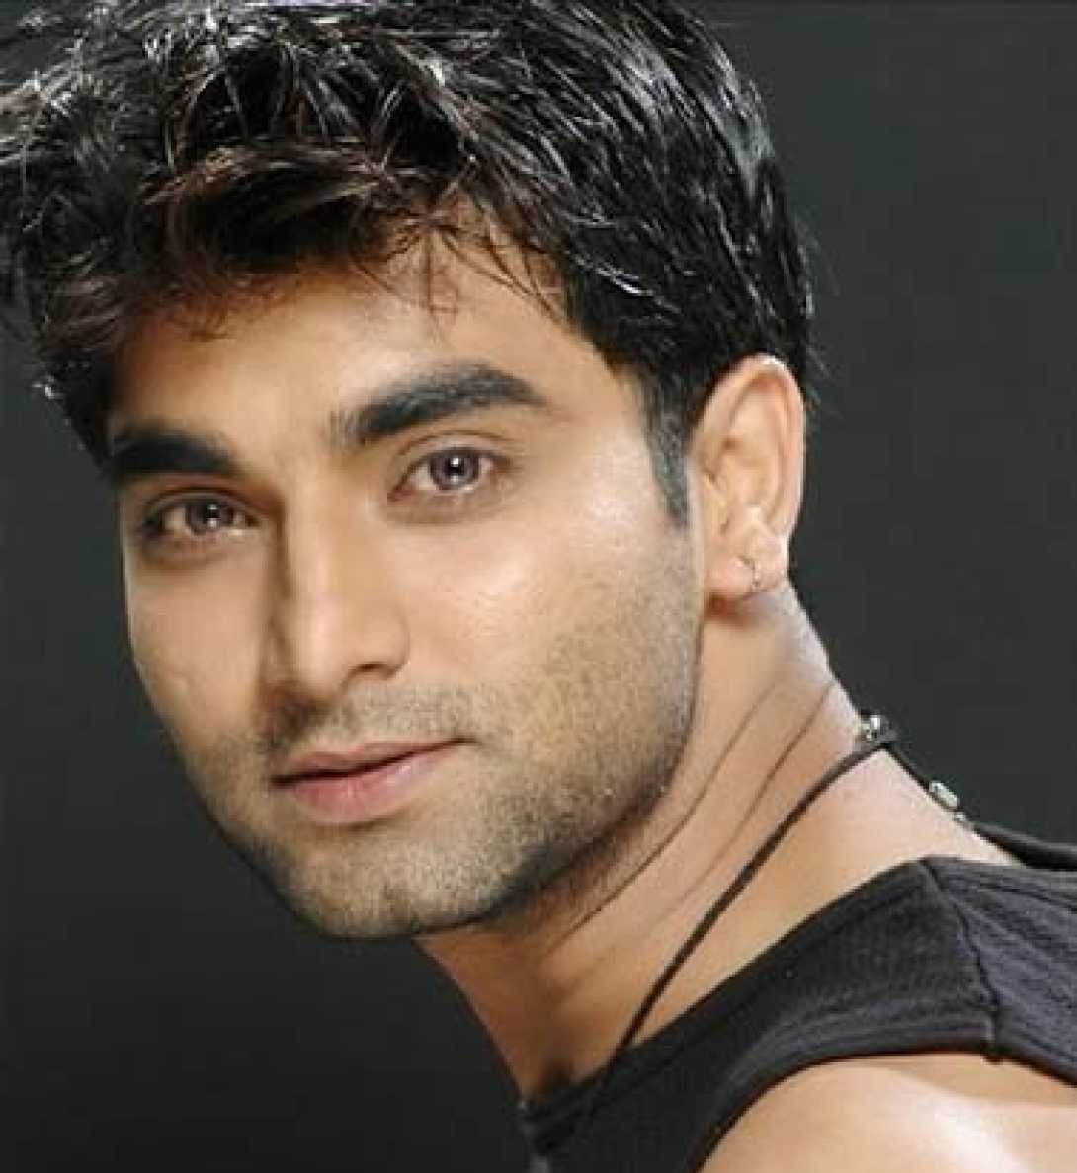
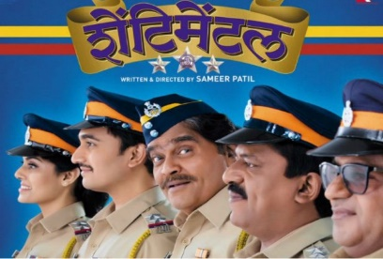
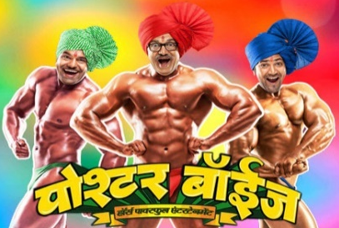
Year Down
It is a story of Janmajay who decides to go back to college after 12 years to fulfill his father in law’s perquisite of graduation degree for marrying his daughter.
His journey of juggling between college life and love life is a completely fresh take on matured love story
Santosh Juvekar
Creds- lead- Marathi movies Zenda, Ek-tara, Morya
Pallavi Patil
Creds- lead- Marathi movie Shentimental
Director
Sameer Patil
Writer
Sameer Patil

Slide 14
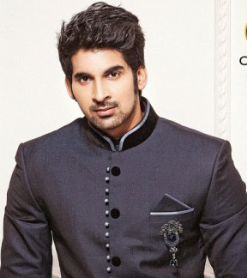
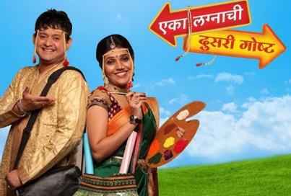
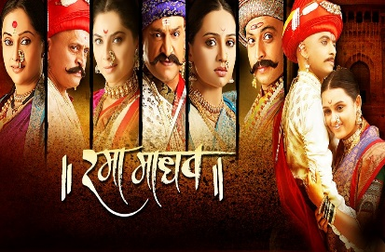
ती फुलराणी Ti Phulrani
Manju Kadam is a fiery, intelligent, confident girl working as a maid in the rich, sophisticated Deshmukh household. Manju is driven by a dream to rise above the lower working class.
Shaunak, the son of Deshmukh family gives her an offer to train and groom her into an upper class, polished girl.
The title carries a rich legacy of legendary Marathi writer P.L. Deshpande and the play
Akshay Waghmare
Creds- Youthful face of Marathi movies
Mayuri Wagh
Cred- Lead cast of Zee Marathi series Asmita
Writer
Manaswini
Director
Sanket Pawse

Slide 15
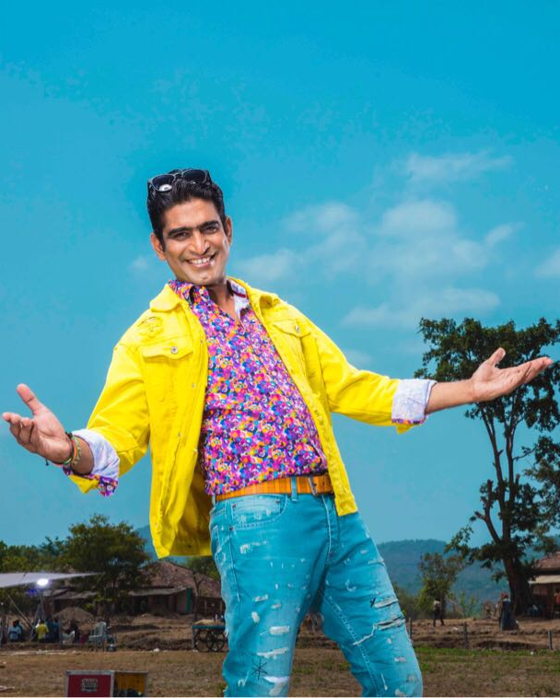
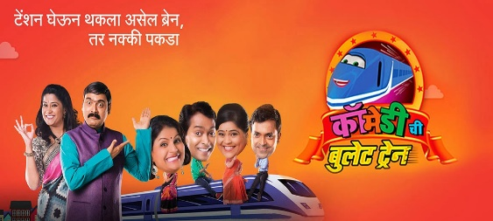
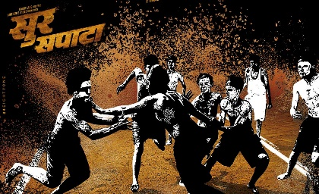
दुनियादारी फिल्मी इश्टाईल Duniyadaari Filmy Isshtyle
This is a story of Raja who is a movie buff. Not just him but his whole village is a movie buff.
Fueled by his passion he decides to move to city to become an actor but takes up a job of assistant director. Things doesn’t go as planned. Insulted by senior director he decides to come back and make his own movie in his village.
Sneha Chavhan
Creds- Fresh face on Marathi TV
Writer
Ashish Pathre
Director
Mangesh Kanthale

Slide 16
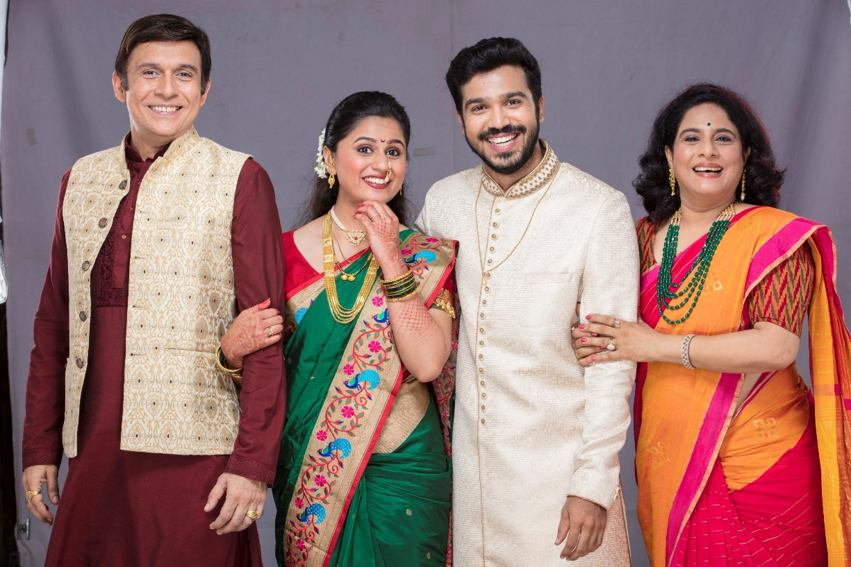
मला हाऊसवाइफ व्हायचंय Mala housewife whayachay
A 23yr old TV serial buff wishes to be the ideal TV bahu any saas yearns to have... but is struck by reality when her liberal saas comes in the picture and offers her the freedom to maintain her own identity!
Tushar Dalvi, Shaswati Pimpalkar, Ashay Kulkarni, Shubhangi Gokhale
Creds- Renowned faces of Marathi TV & Films
Writer
Madhugandha
Director
Swapnaneel

Slide 17
गर्जा महाराष्ट्र Garja Maharashtra
GAURAV-GEET
Tracing Maharashtra’s journey from 600 BC till 1960
A TV series that will present many unknown facts about history of this land
A TV series that revisits Maharashtra’s unsung glorious past that unites the Marathi minds & ignites pride in their hearts.
for the rich heritage that Maharashtra stands for

Slide 18
NON-FICTION

Slide 19
Comedy has always caught attention of Marathi audience
Judges
Glamorous faces of Marathi industry
Prasad Oak
National award winning director/ actor
Sai Tamhankar
Top actress of Marathi film industry

Slide 20
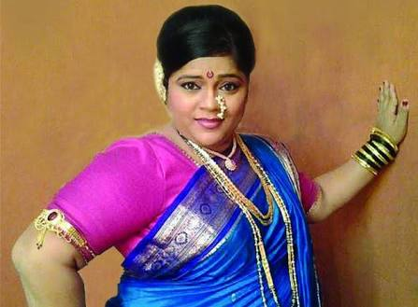
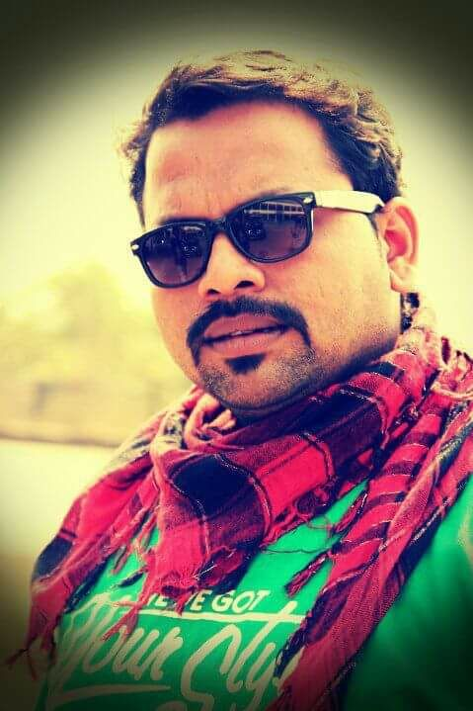
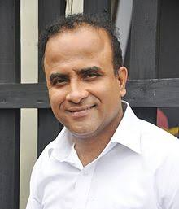
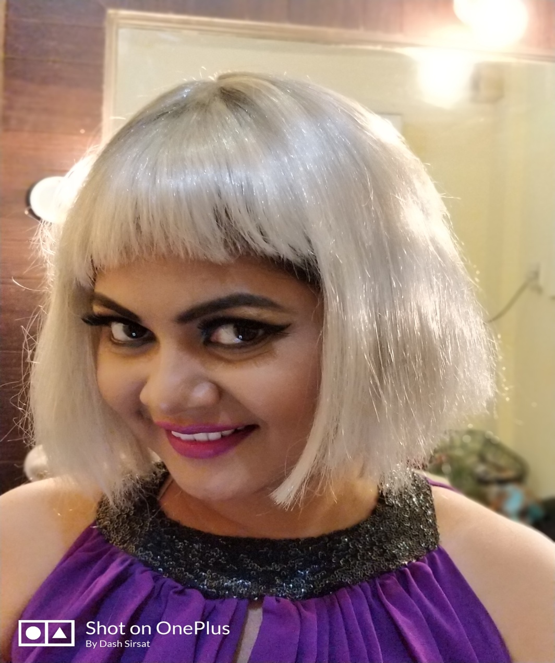
Most credible comedians are team captains
Vishakha Subedar
Sameer Chougule
Prasad Khandekar
Namrata Awate

Slide 21
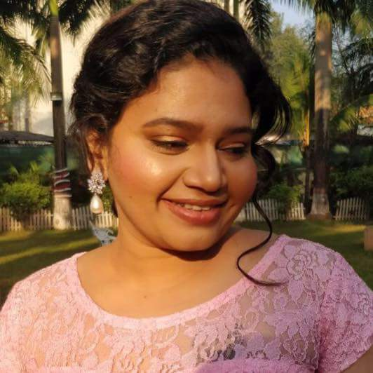
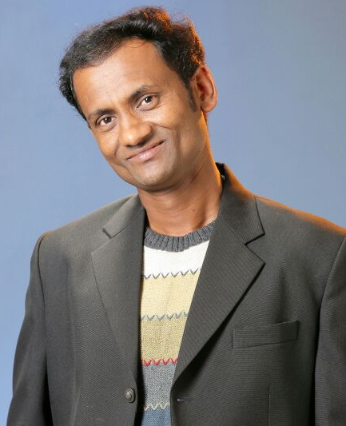
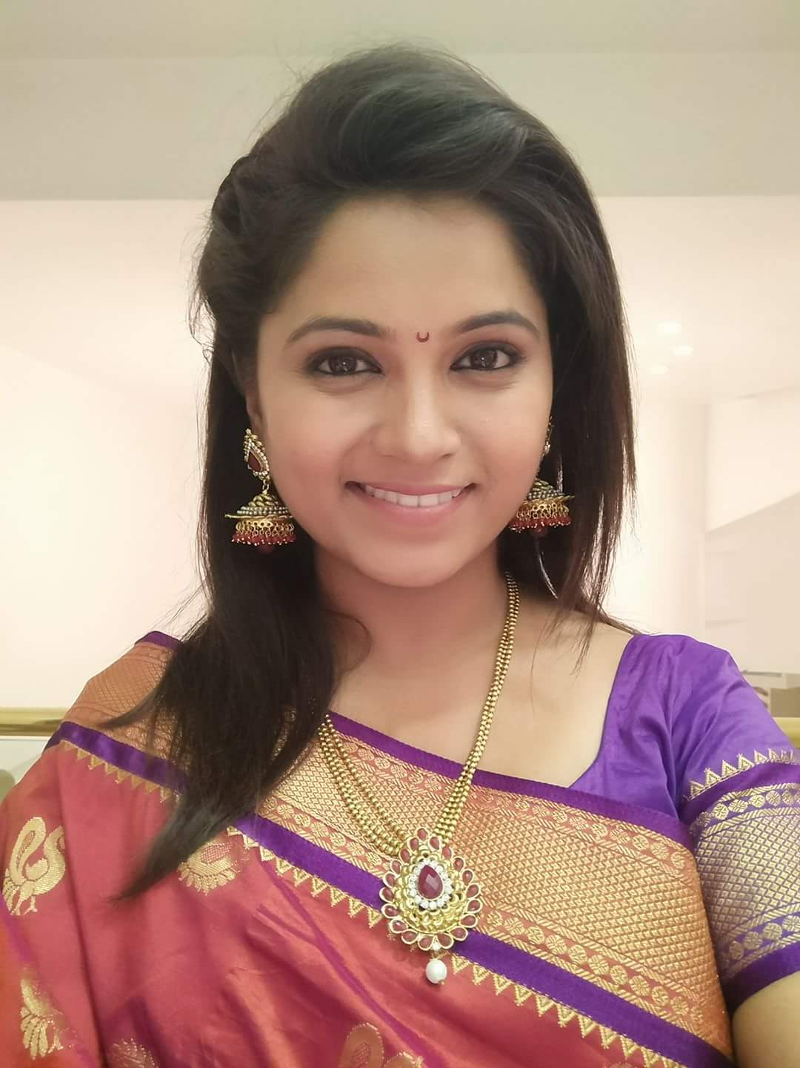
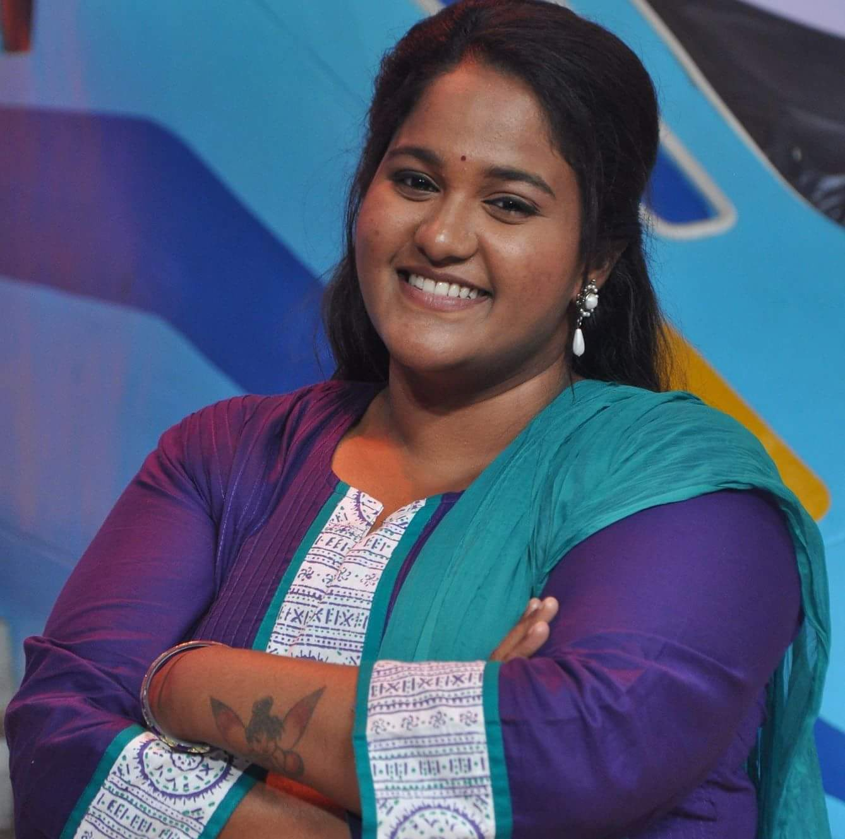
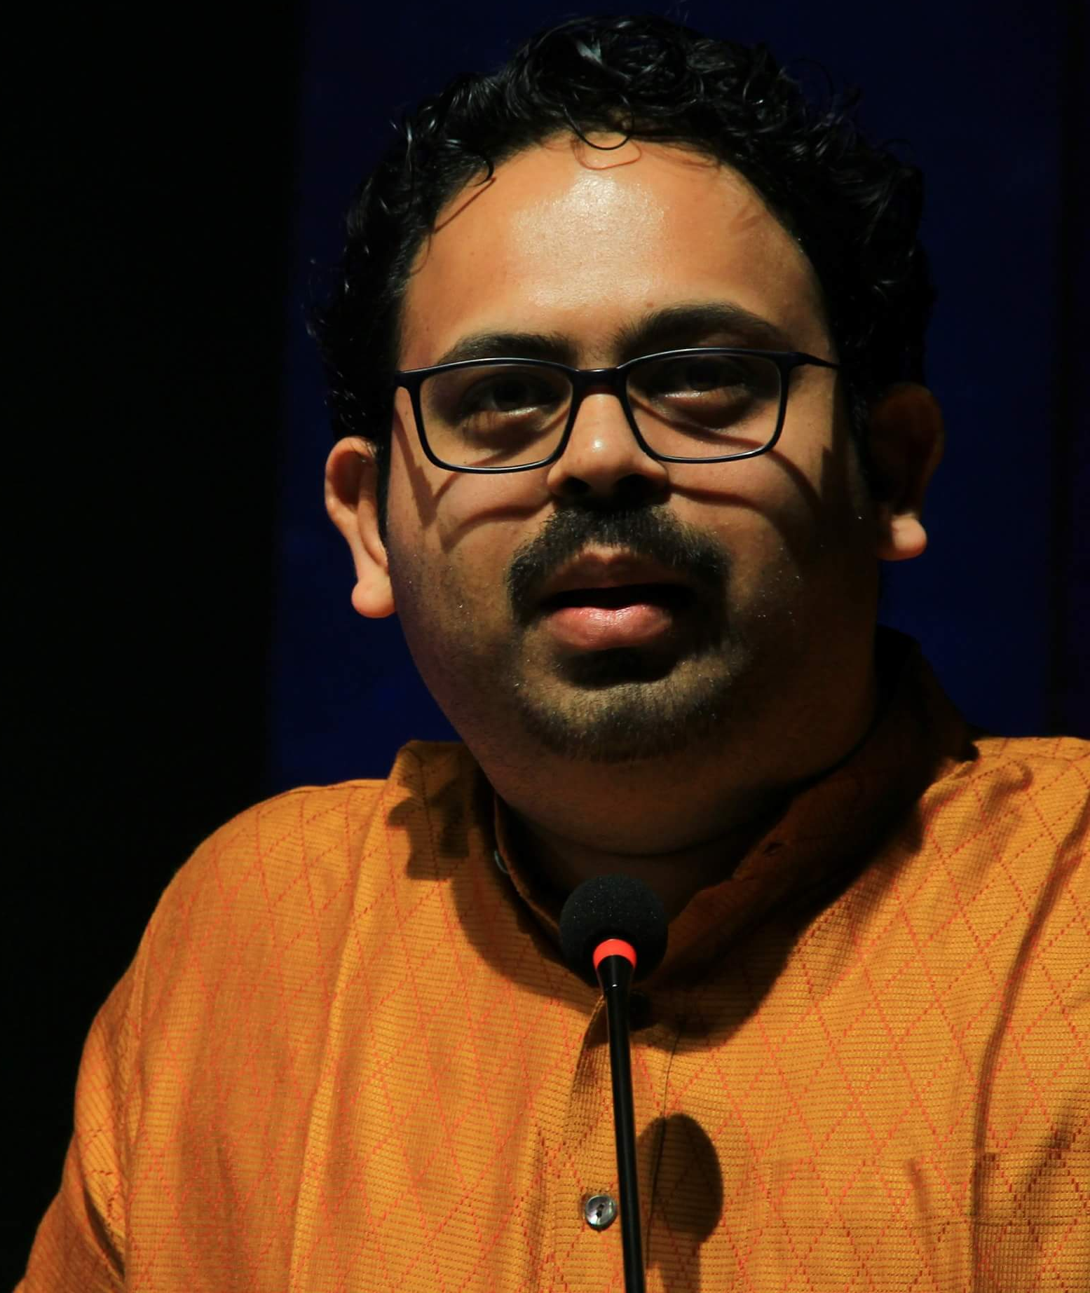
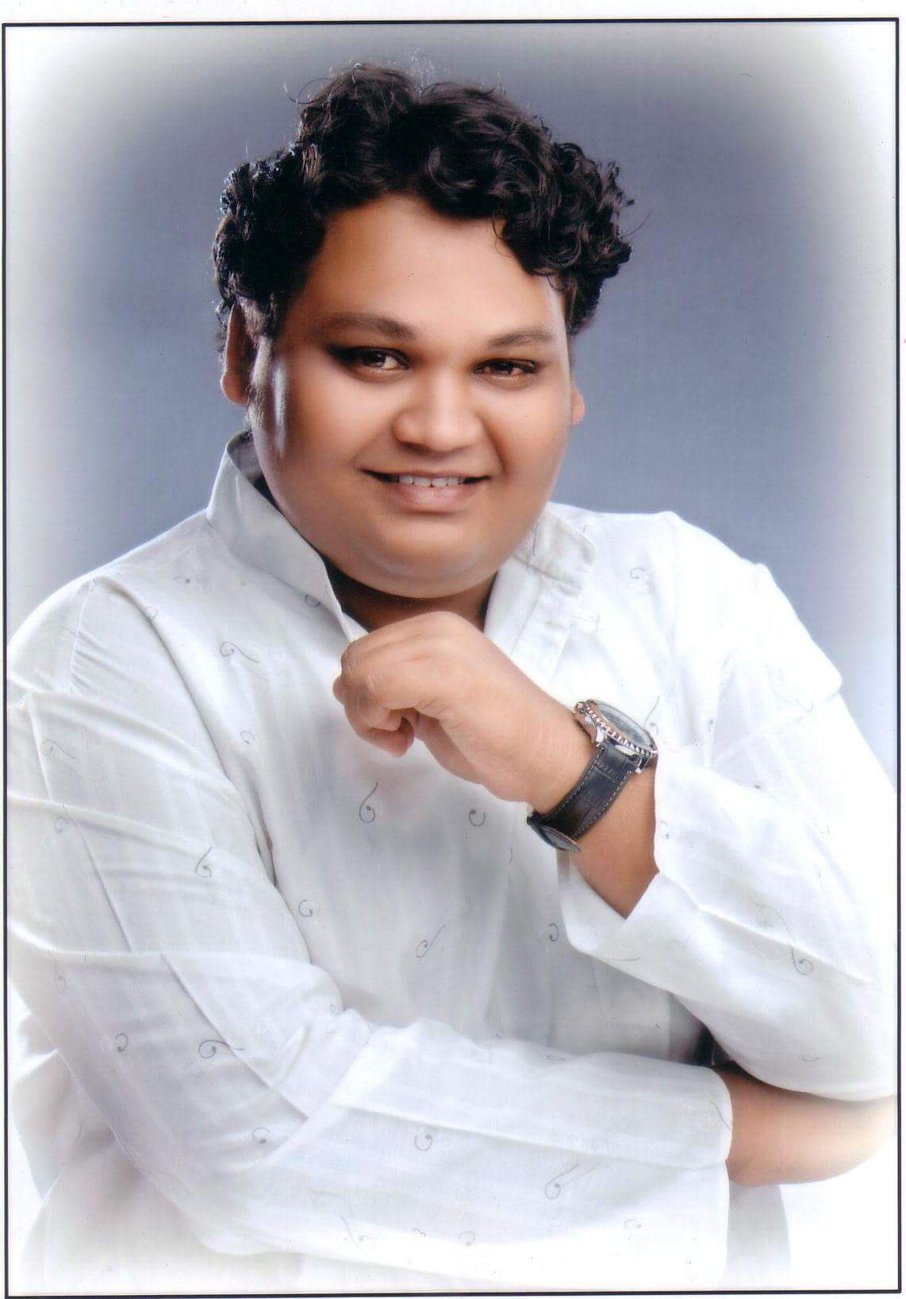
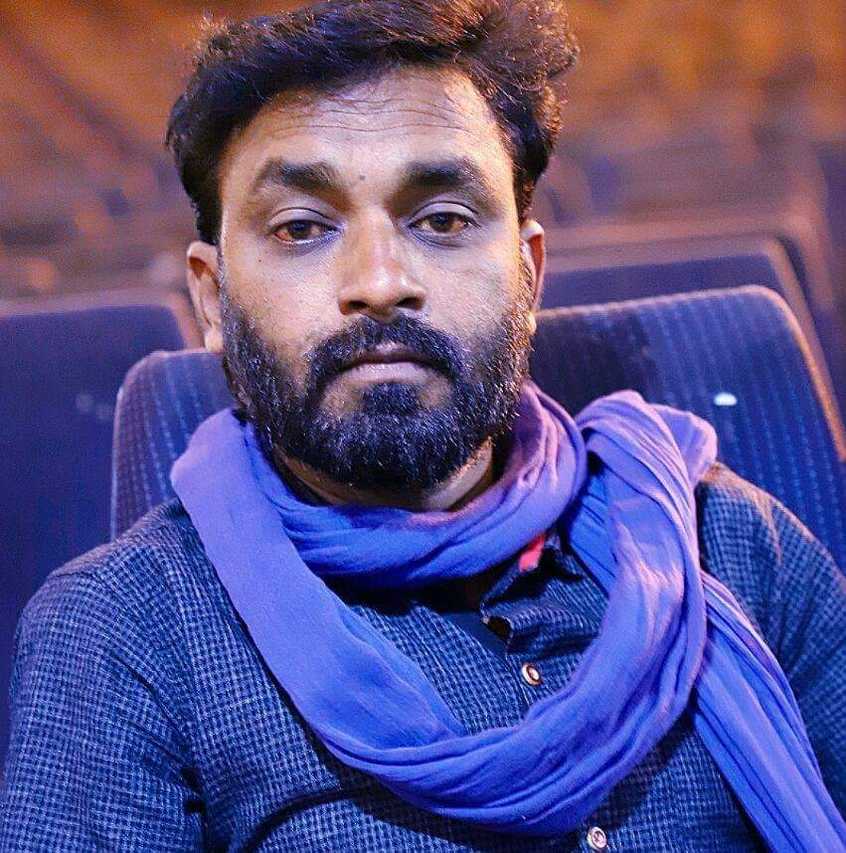
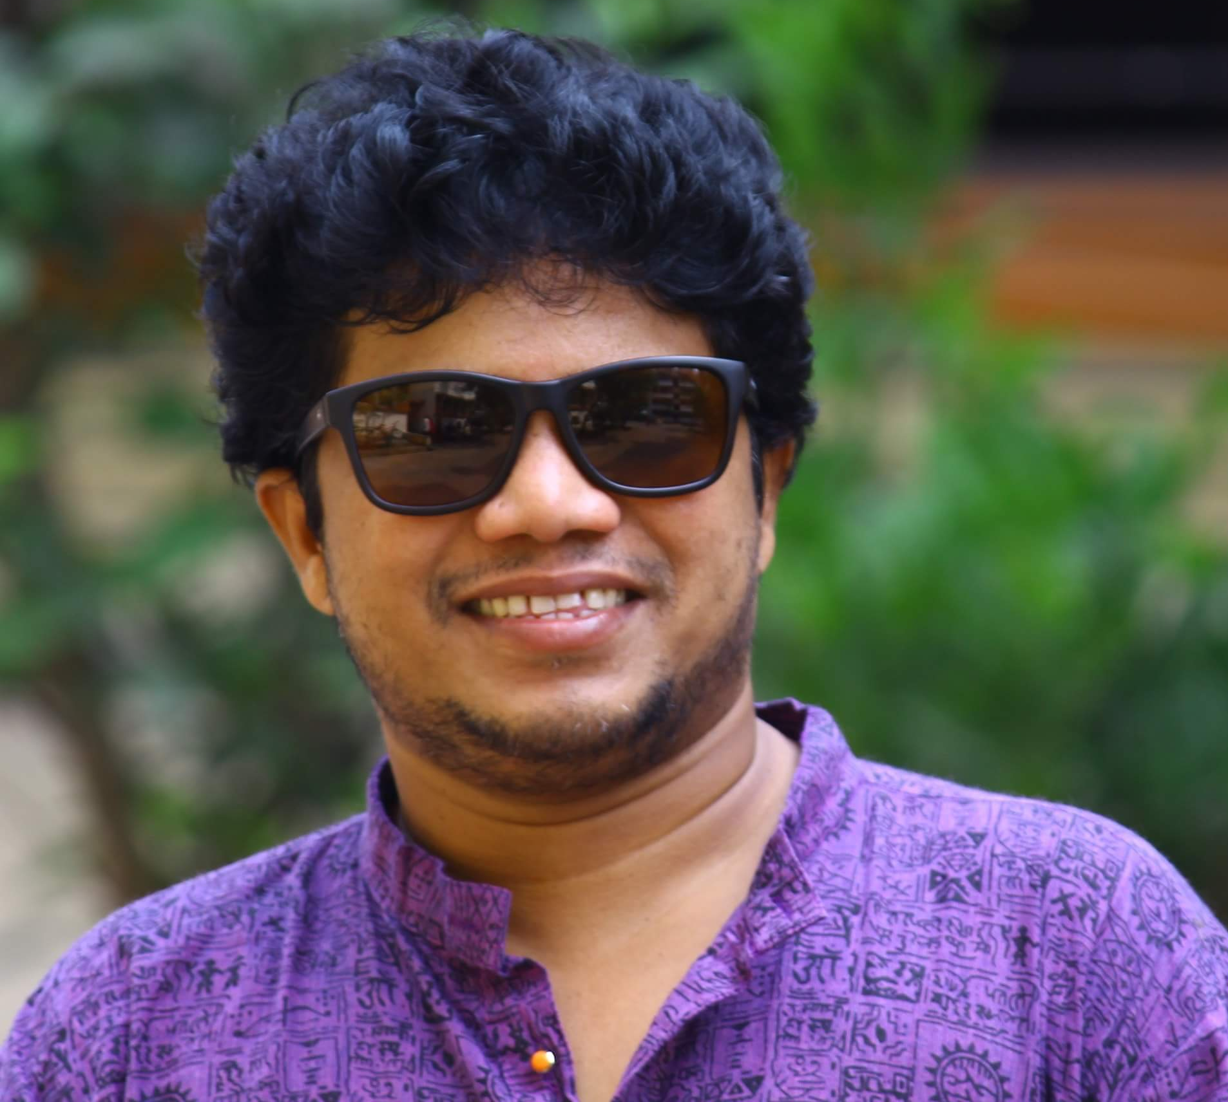
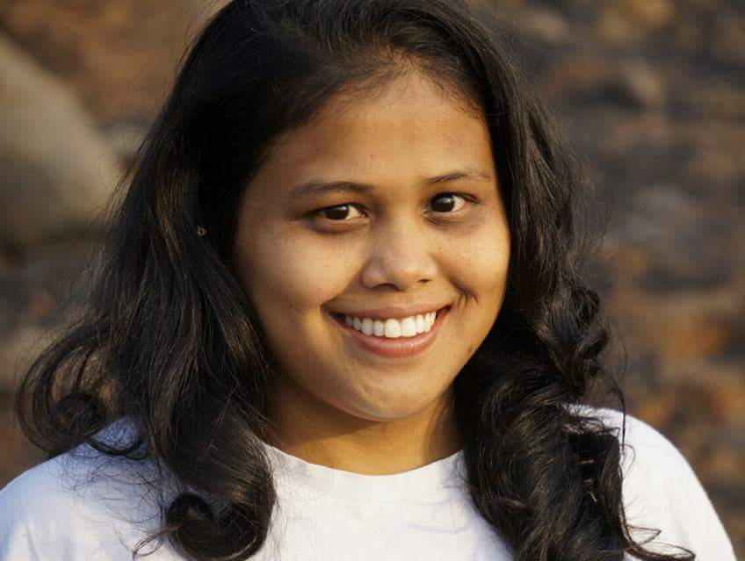
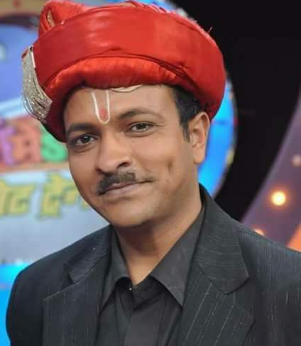
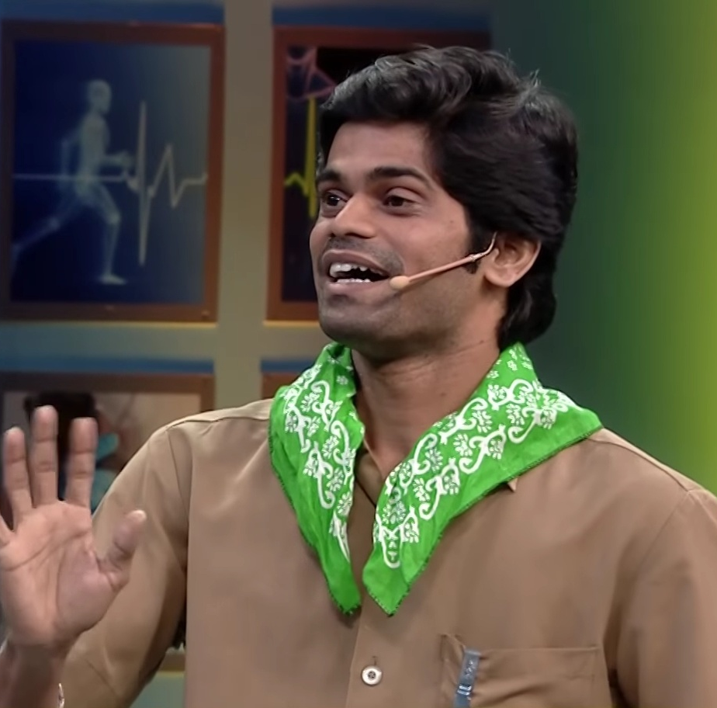
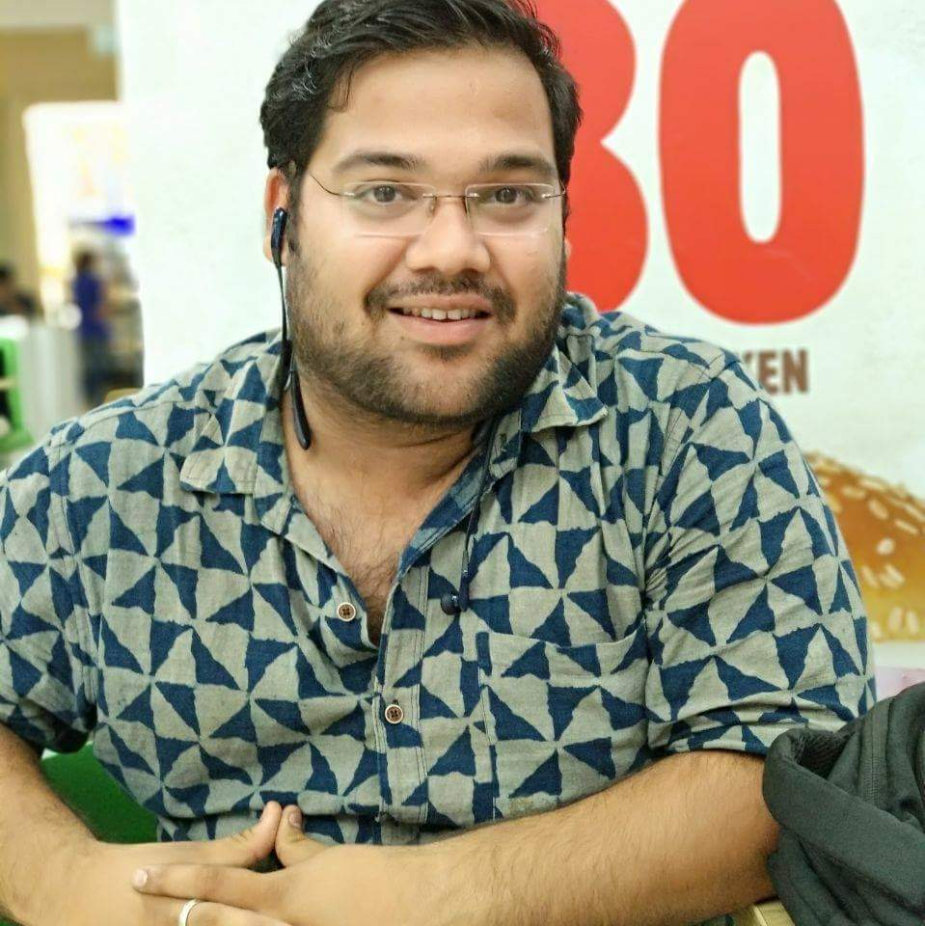
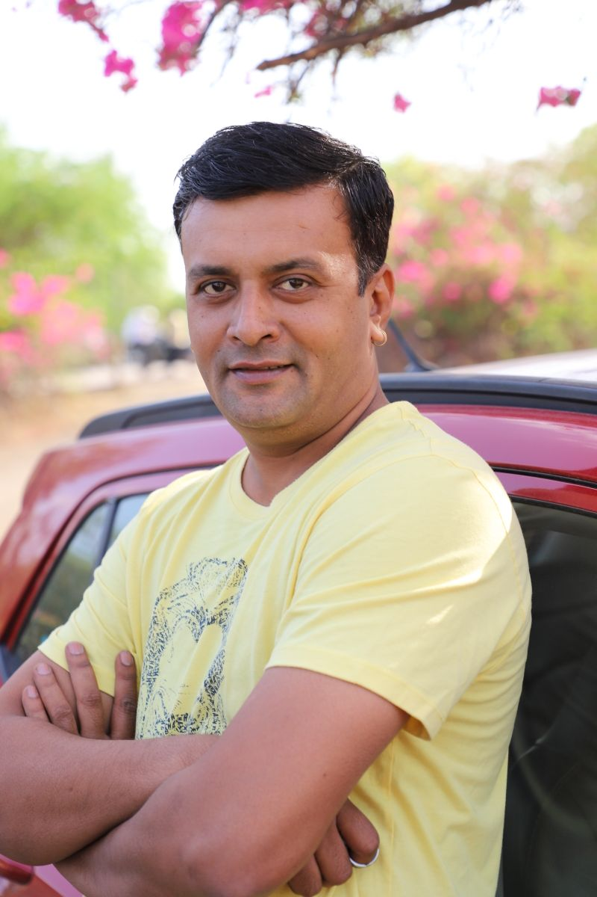
Maharashtrachi Hasya Jatra
Concept
Standup comedy though an old form of entertainment has now caught fancy of the audience and is mushrooming
Hasya Jatra is a melting pot of comedians from all parts of Maharashtra representing diverse dialects and lifestyle
The participants are known faces and audience love them for their comic timing.
Hasya Jatra is a unique competition between standup comedians to win the ultimate title of “Comedycha Jahagirdar”
These participants enjoy great credibility on TV as well as dramatics thus ensuring quality of the content

Slide 22
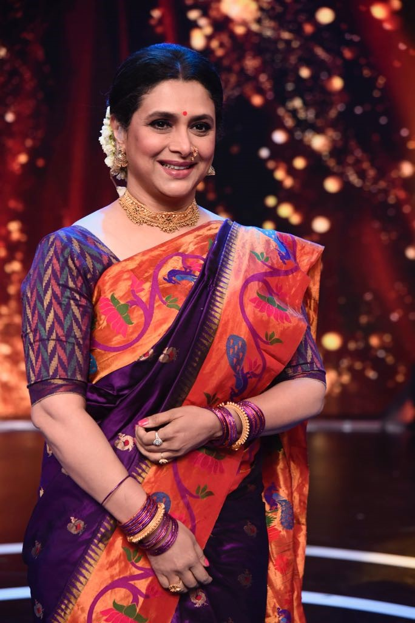
Dance Reality Shows are timeless and the format is promising
Grand Judge
Supriya Pilgaonkar
One of the most honored dance expert and winner of a dancing show

Slide 23
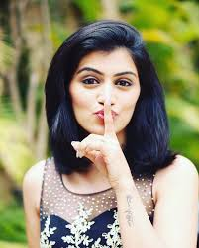
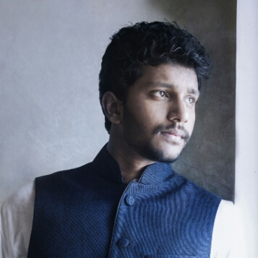
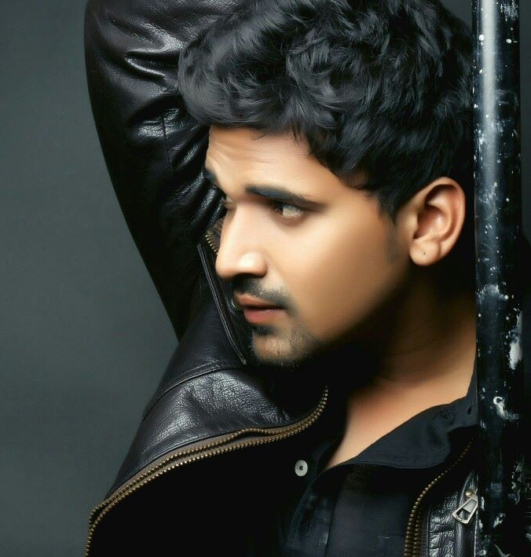
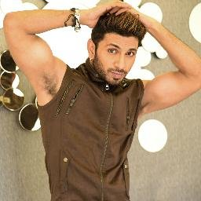
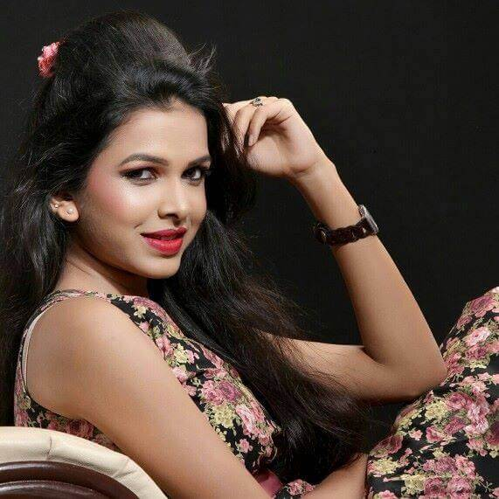
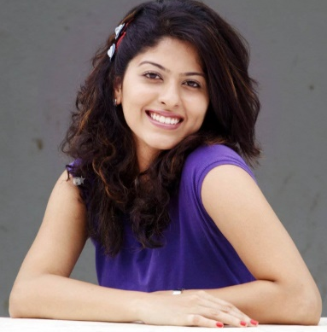
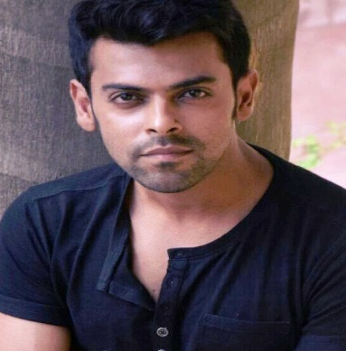
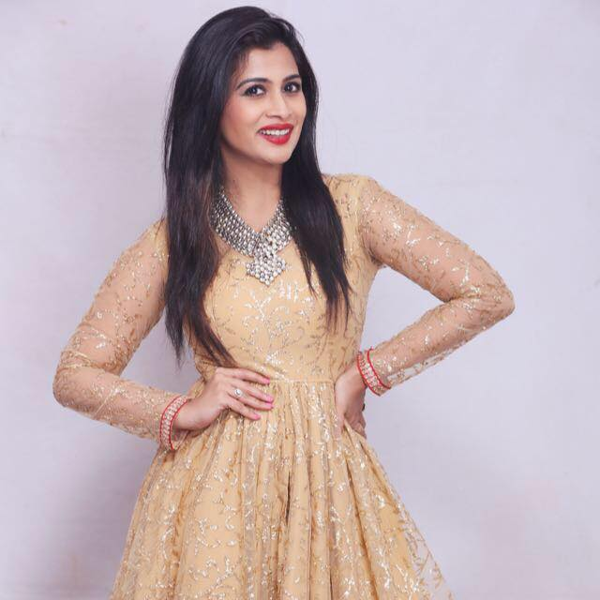
Maharashtracha Favourite Dancing Star
Concept
Solo dance competition of celebrities
The celebrities chosen are choreographers or qualified dancers who can deliver finesse in their performances
The celebrities will be divided in teams and lead by equally big choreographers
A grand judge will judge the performances and the mentors
Sneha Chavhan
Apoorva Ranjankar
Siddharth Khirid
Gauri Nalawde
Abhijit Thakur
Mitali Mayekar
Abhidnya Bhave
Rohan Gujar
Ruchita Jadhav

Slide 24
MOVIES

Slide 25
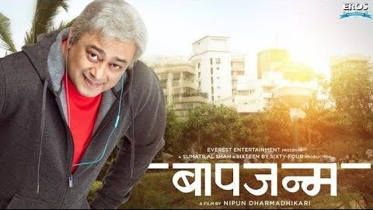
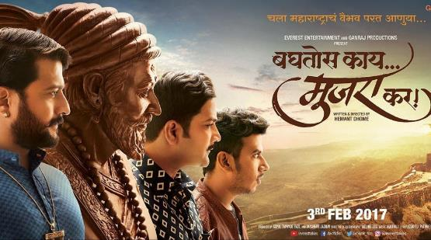
Popular Titles for World Television Premiere

Slide 26
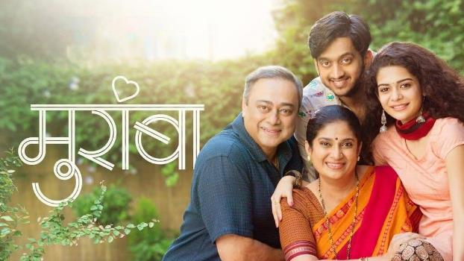
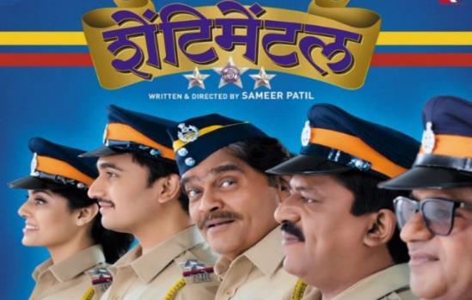
Award winning titles for World Television Premiere

Slide 27
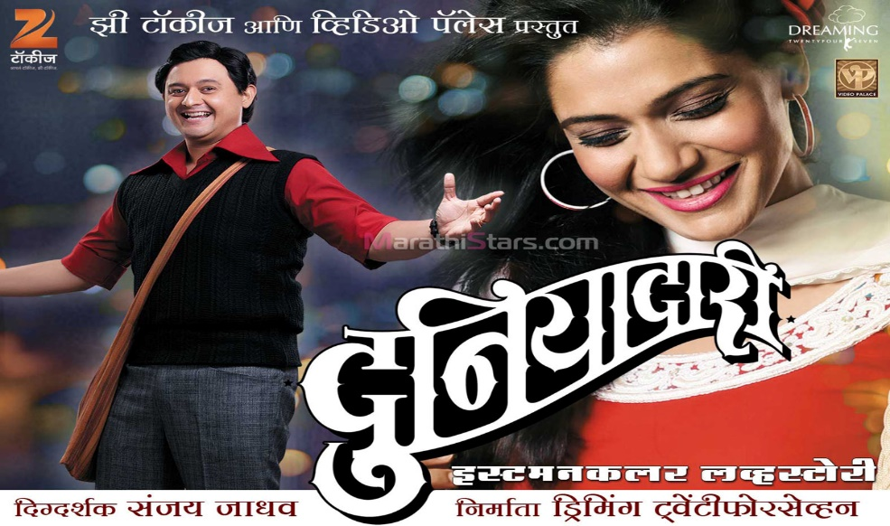
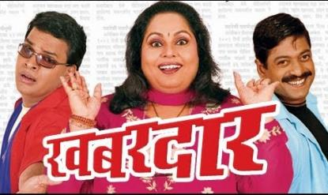
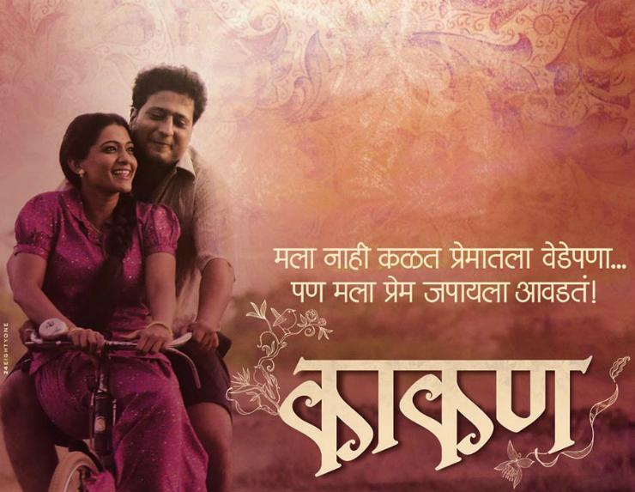
Maharashtra’s all time favorite movies

Slide 28
EVENTS

Slide 29
Maharashtra Rajya Chitrapat Puraskar Sohla
The most credible and highly regarded awards
A Government of Maharashtra initiative to honor and celebrate exceptional Marathi films and artists
Conceptualized in 1963, this event is the most awaited and grabs highest audience
The event is attended by all the prominent Marathi celebs and the acts performed are best in the industry
Awards are bestowed in the presence of the Hon’ble Chief Minister – Mr. Devendra Fadnavis and Hon’ble Cultural Minister – Mr. Vinod Tawde

Slide 30
Top Marathi celebrities lend glamour to the event
Stars of the event
Quality acts performed by top celebs with highest audience affinity and clout
Anchors
Esteemed faces of the Marathi Industry, who are known for their wit and charm take the helm and lead us into a evening of celebration and entertainment

Slide 31
Sony मराठी A mix of fiction & non-fiction
Fiction
Non-Fiction
Events
Ti phulrani
Maharashtrachi Hasya Jatra
Rajya chitrapat sohla
Mala Housewife vhaychay
Maharashtracha favorite dancer
Diwali event
Duniyadaari filmy isshtyle
Hrudayat vaje something
Movies
Sare tujhyach sathi
Library of 100+ movies
Hum Bane Tum Bane

Slide 32
Journey Begins…

