Slide 1
Flying to 2020
Re-imagine - Airport Experience
By Amit Bhopi
Notes:
Note: Please after inserting your picture, “Right Click” on the picture and “Send it to Back” to get the “Gradient” effect.

Slide 2
The Process
01
Empathize
02
Define
03
Ideate or Fact Finding
04
Solution offering
Low Fidelity Prototype
05
Test
Omitted for this exercise

Slide 3
What, Why & How?
Decode & encode
What?
Why?
How?
Airports are turning to any method they can think of to banish airline delays -- including crowdsourcing and computer algorithms -- but running down the security gauntlet, dealing with paperwork and procedures as well as the delights of the border can not only frustrate the customer, but limit the amount of available time slots for planes to take off.
Airports are becoming congested and security is at an all-time high, so management now face an uphill struggle; keeping the business in profit, maintaining security, coping with increased competition and of course, the ever-present threat of adverse weather conditions.
Here we will try and present a solution to address issues and problems faced by airport users: Staff and Flyers.

Slide 4
User: Nita Kumar
34, Sr. Exec in an MNC; a mother of a toddler; High achiever; independent with high self esteem; Travels around the world
HABITS
Loves to spend time with her daughter
Gives her best in her profession and takes any challenge head-on
Likes to plan in advance to the very last of details
Very punctual and values her and other people’s time
GOALS
To be professionally successful without sacrificing much time with her family
To spend minimum time at airports while travelling on a business trip
To be well prepared for any situation with meticulous planning
Notes:
Note: Please after inserting your picture, “Right Click” on the picture and “Send it to Back” to get the “Gradient” effect.

Slide 5
Nita’s travel dilemma
Nita loves to travel but her current airport experience is riddled with uncertainties and unwanted surprises also this time she is travelling with her 3 year old daughter alone
Travel anxiety
The pressure from leaving home, finding transport to boarding the flight
Airport formalities
Entering airport, taking boarding pass, immigration, finding boarding gate
Security check
The most tedious and time consuming for both the passengers and the staff
Final Boarding process
Showing boarding pass at the boarding gate and then again to the airline staff and sometimes to the security again
Notes:
Note: Please after inserting your picture, “Right Click” on the picture and “Send it to Back” to get the “Gradient” effect.

Slide 6
Current Experience
Typical experience Nita goes through before flying
The beginning of the journey
The boarding pass & check in
Immigration check
Nita is already anxious, she is worried about baggage weight, food for her child and commute to the airport
After wheeling the luggage, multi-tasking carrying her child and keeping a check on her baggage she again has to show her documents
Something Nita always felt wastes a lot of her time, finding the counter & reading the rules whilst at the airport is overwhelming
STAGE 01
STAGE 02
STAGE 03
STAGE 04
STAGE 05
STAGE 06
Low Stress
Enter the airport
Security check
Boarding the flight
Medium Stress
High Stress
Nita has reached the airport, a bit delayed due to uncertain traffic jam. She now has to show her documents to the security to gain entry
Something Nita always felt uncomfortable with, removing belt, shoes, jewelry, laptop and arranging those in trays
Finding the boarding gate, showing the boarding pass and walking the plane aisle to find the seat

Slide 7
The Cycle
What goes around, comes around
Problems are mostly caused by misunderstandings between staff and passengers. While the air travel system is unfriendly to passengers, they get confused and stressed, which causes them to perform worse. While passengers too behave incorrectly, the staff lose patience and also get stressed, which makes the travel system even more unfriendly to the passengers.
Passenger is stressed
A unfriendly travel system
Passengers perform worse
Staff lose patience

Slide 8
Findings
Notes:
Note: Please after inserting your picture, “Right Click” on the picture and “Send it to Back” to get the “Gradient” effect.

Slide 9
The Problems
The entire process is not seamless and very confusing even for a regular flyer.
Nita has to interact with different individuals from time to time
Airline or Travel website/App
Cab app & cab driver
Airport ground staff
Security (Entry at the airport)
Airline staff (Boarding pass and Baggage)
Airport staff again
Government staff (immigration)
Information received is sometimes blurred
Staff at the airport though could be well trained but are stressed after catering to the galaxy of humans they deal with
Signages at the airport could be confusing
What does this sign mean Go Up or Go Straight?

Slide 10
Solution
For this exercise we will define solutions for Stage 3 & Stage 4
(Reference Slide 6)
Notes:
Note: Please after inserting your picture, “Right Click” on the picture and “Send it to Back” to get the “Gradient” effect.

Slide 11
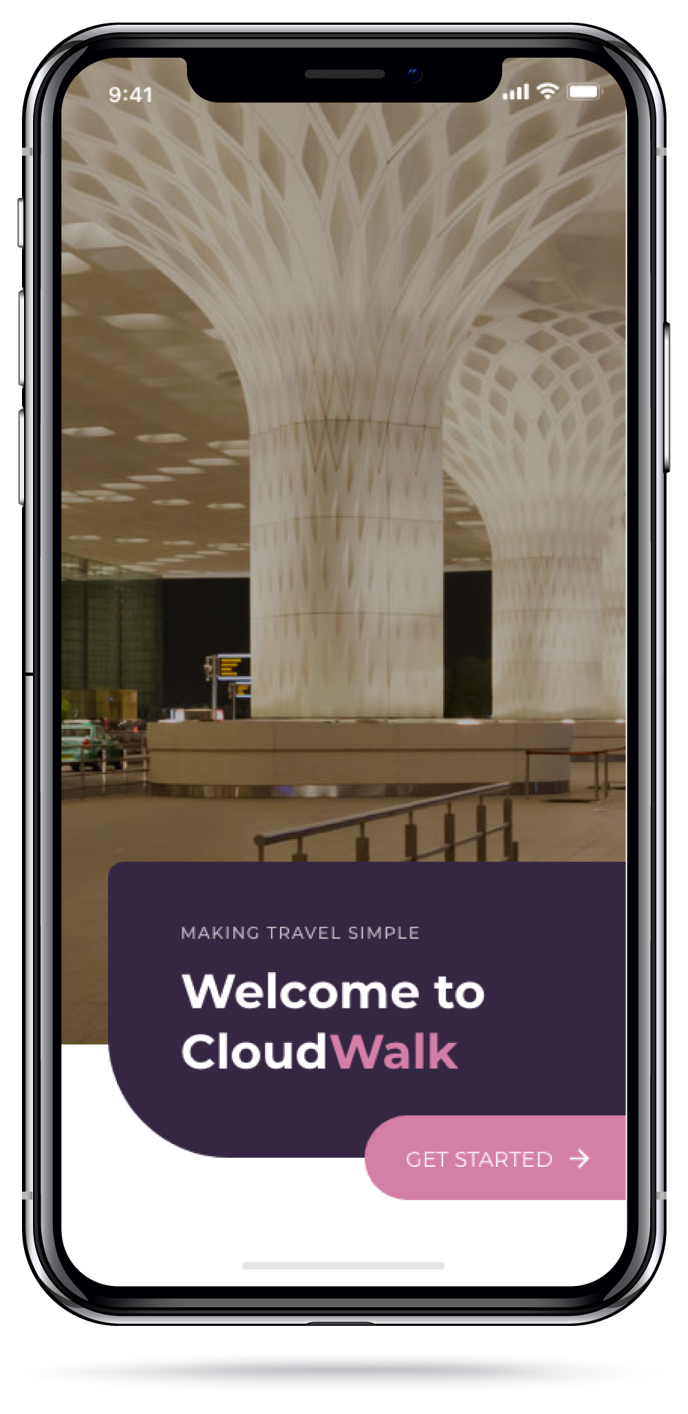
Cloud Walk
Introducing CloudWalk.
Is a mobile app, live help for flyer
CloudWalk is a mobile app
It is a integrated solution for Nita
Nita simply has to install CloudWalk from Google Play or Apple App Store
Enter her ticket details and mobile number
CloudWalk will now take over, assist and help Nita walkthrough step by step from the moment she enters her ticket details in the app till she reaches her seat in the airplane

Slide 12
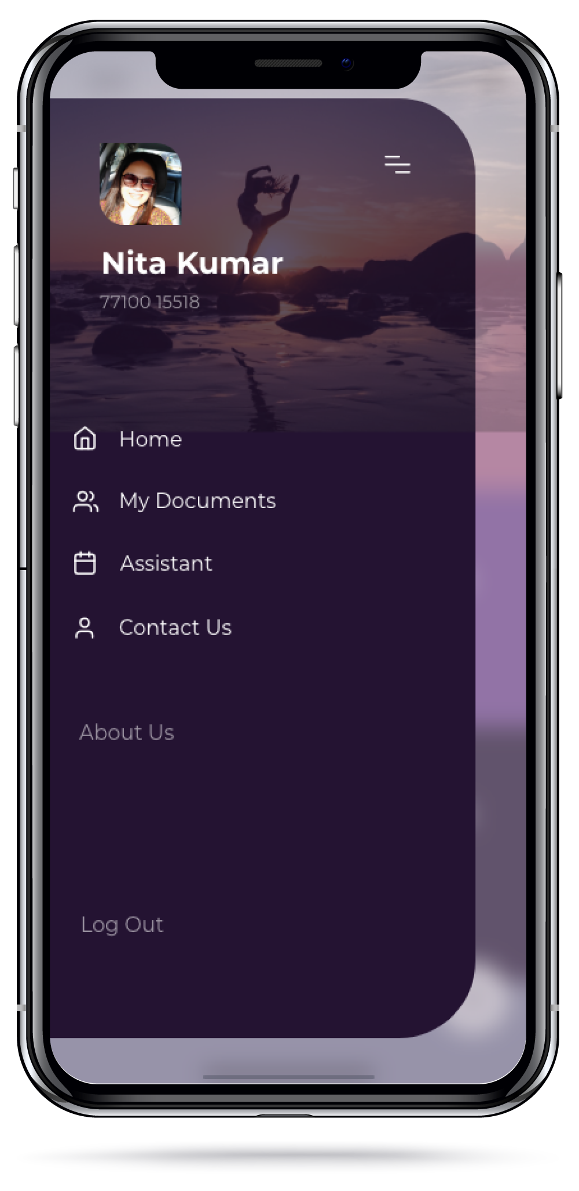
Cloud Walk
How does CloudWalk Work?
Is a mobile app, live help for flyer
Once Nita has entered her ticket details CloudWalk takes over
CloudWalk will remind and assist Nita in every step, only thing Nita has to do is respond to CloudWalk’s periodic notifications and follow them
CloudWalk with its other integrated solutions will minimize human intervention and eliminate ambiguity
CloudWalk will be Nita’s guide to make her entire airport experience a walk in the clouds

Slide 13
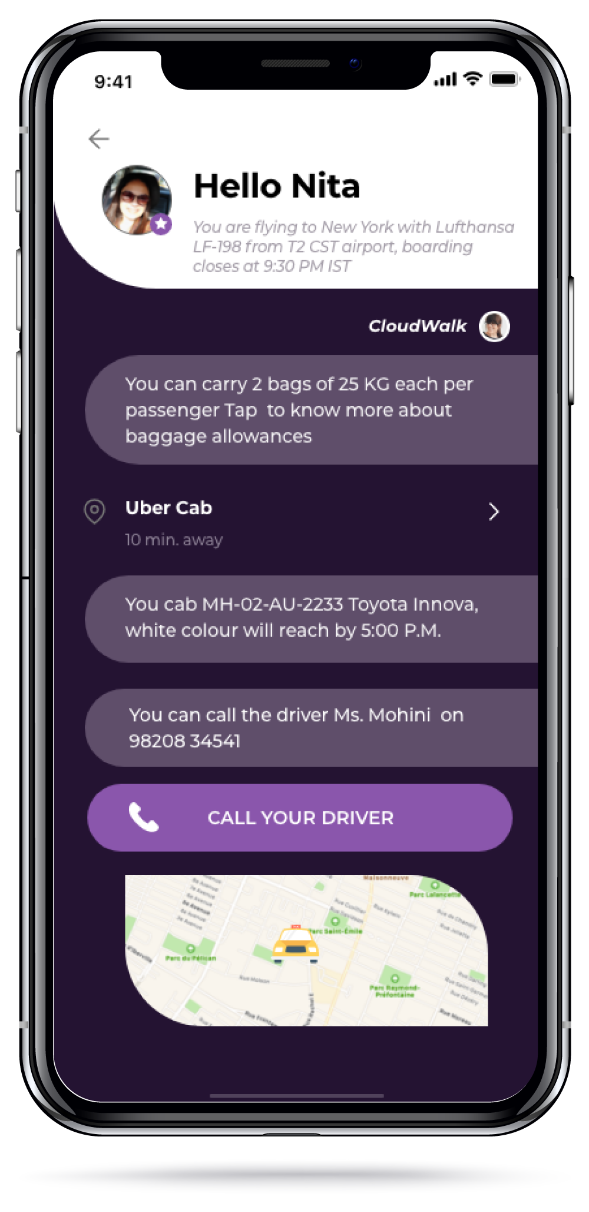
Cloud Walk
What will CloudWalk do?
Is a mobile app, live help for flyer
1. Leaving for the airport
CloudWalk will inform Nita about baggage limits, not to carry items a few days before travel date.
CloudWalk will give Nita tips on how to make her travel easy (Destination info, weather, vaccinations, etc.)
It will source information and tell Nita about latest updates about the airline, airport & destination
It will help Nita help book a cab in advance, so she doesn’t have to spend crucial time on the day of the travel looking for a cab, neither has to multi-task (This is optional for Nita)
CloudWalk knows Nita is travelling with a child and thus can offer to book porter services
It will store Nita & her child’s ticket info
Cloudwalk will tell her exactly which gate she has to alight at the airport, this will also be instructed to the cab driver on their company app.
Nita simply has to open the app and show her tickets stored in the app and her physical passport to the security at the airport entrance Continued….

Slide 14
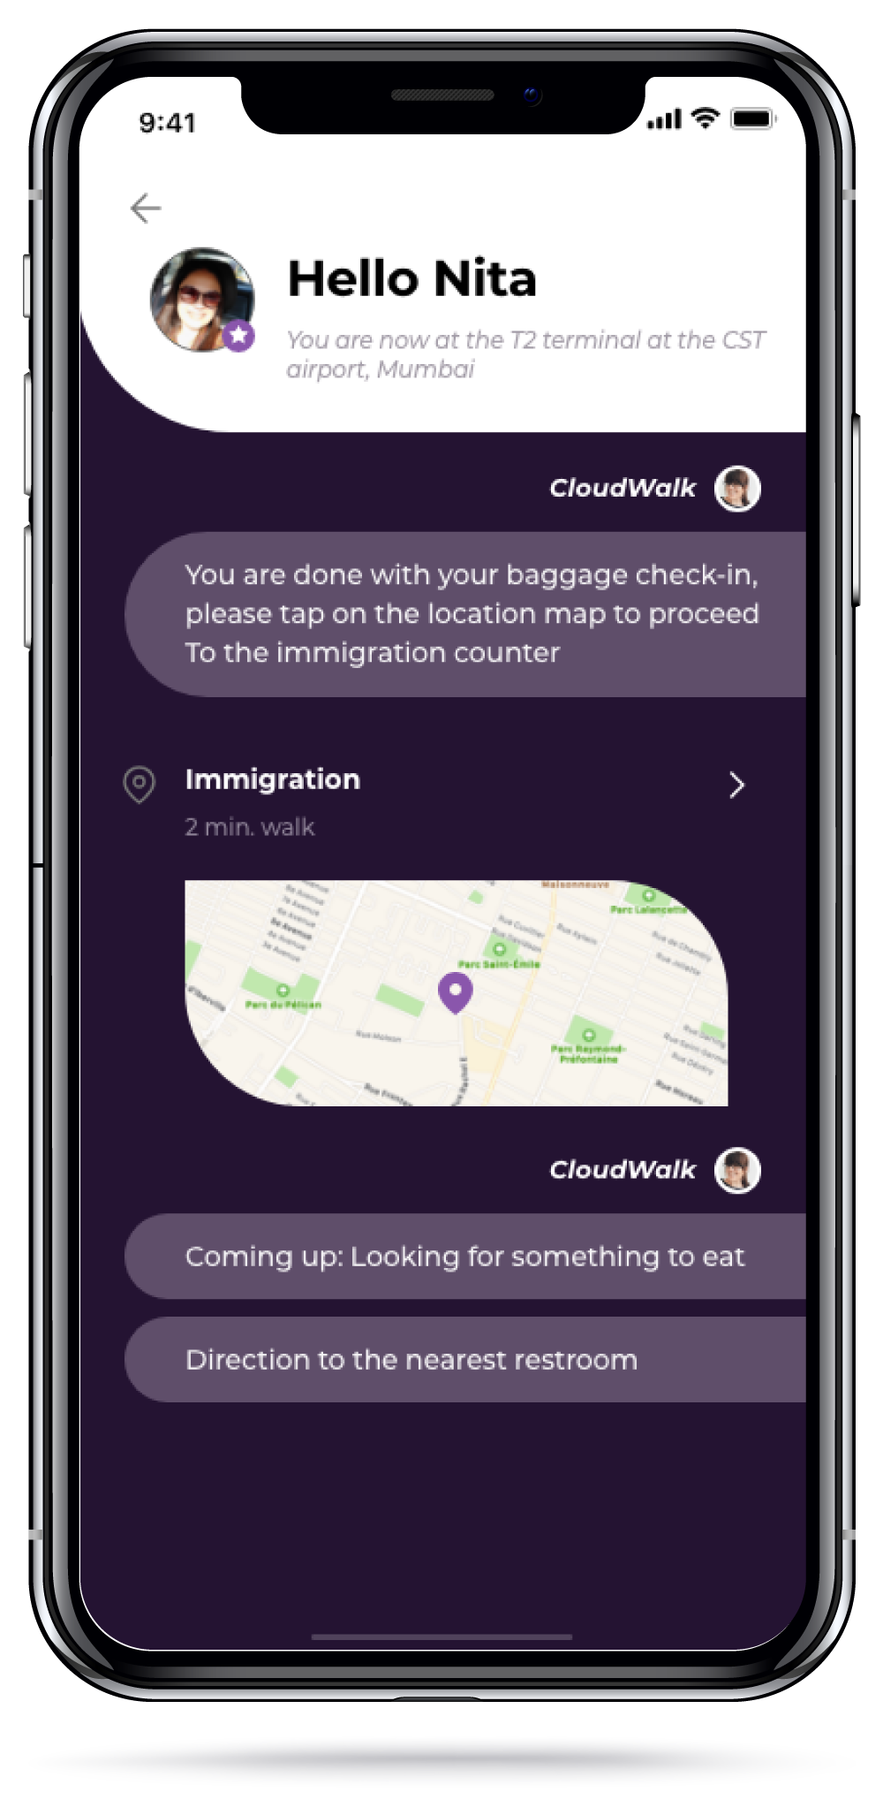
Cloud Walk
What will CloudWalk do?
Is a mobile app, live help for flyer
2. Inside the airport
It will now show Nita a map to reach a particular numbered baggage kiosk, here the kiosk will scan a QR code in the CloudWalk app and advise her to weigh the bags, if the baggage is in limit it will print a slip to be put on the baggage Nita will now get an option to generate the boarding passes for herself and her child in the app
CloudWalk will now show Nita a Map to proceed to a specific baggage belt, here the baggage slip will be scanned and weighed.
Once the baggage is accepted CloudWalk will show Nita live map and visual cues on how to reach the immigration desk
After the immigration formalities, CloudWalk can give optional info for currency exchange, restaurant, restrooms at the airport
Depending on the options Nita chose CloudWalk will help her reach her next destinations Continued….

Slide 15
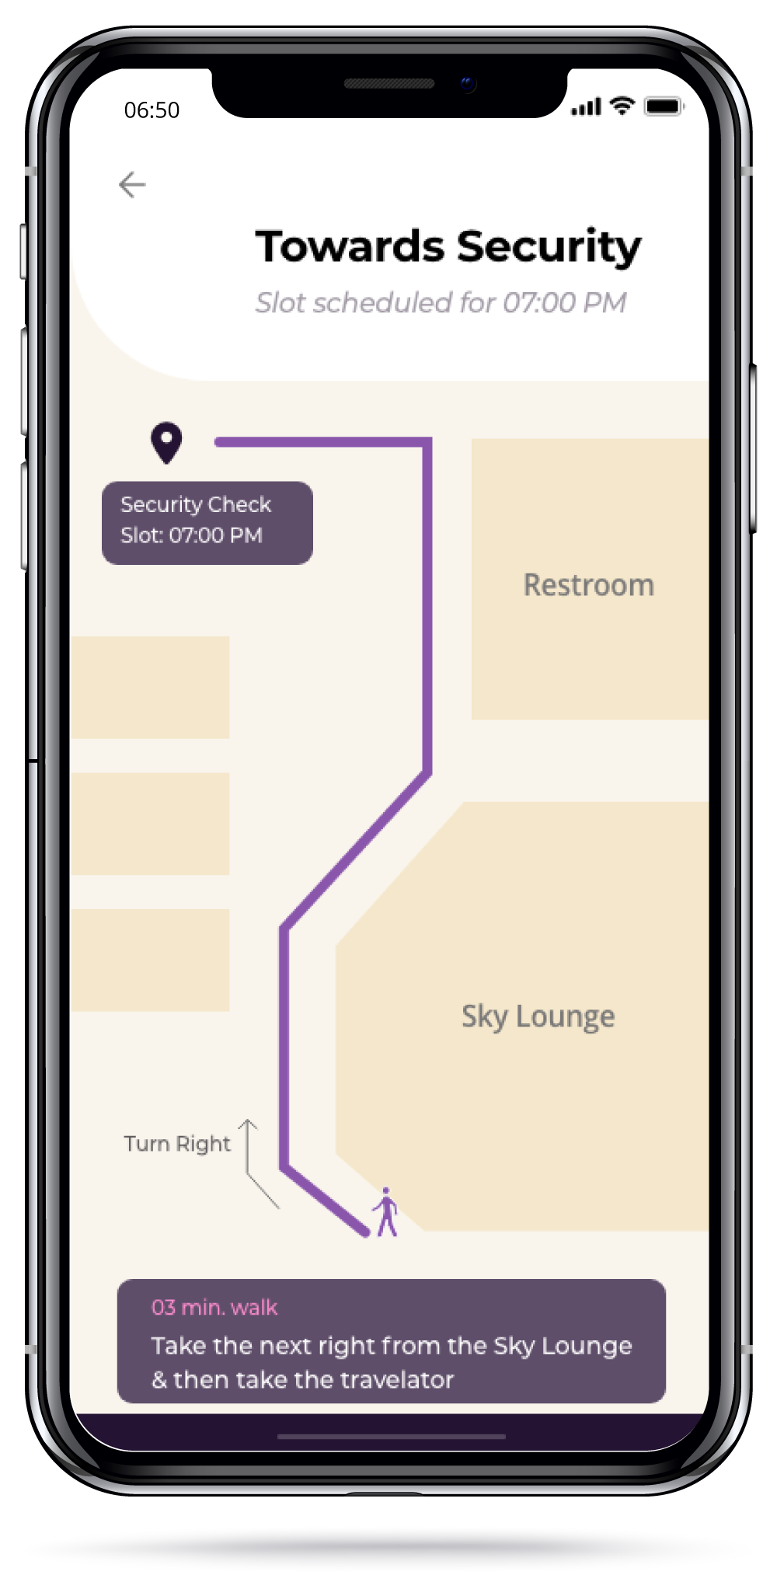
Cloud Walk
What will CloudWalk do?
Is a mobile app, live help for flyer
3. Security check
CloudWalk is offering Nita real time data as she proceeds towards the security check
CloudWalk will estimate, identify and generate a time slot for a particular security desk
As a CloudWalk user Nita’s wait time at the security desk will be to the minimum
The security personnel at CloudWalk enabled desk will scan the QR code thus allowing Nita to proceed, the boarding pass will now have security check complete sign.
CloudWalk will also suggest Nita of other airport services like restaurants, restrooms, Duty Free shops etc. depending how much leisure time she has.

Slide 16
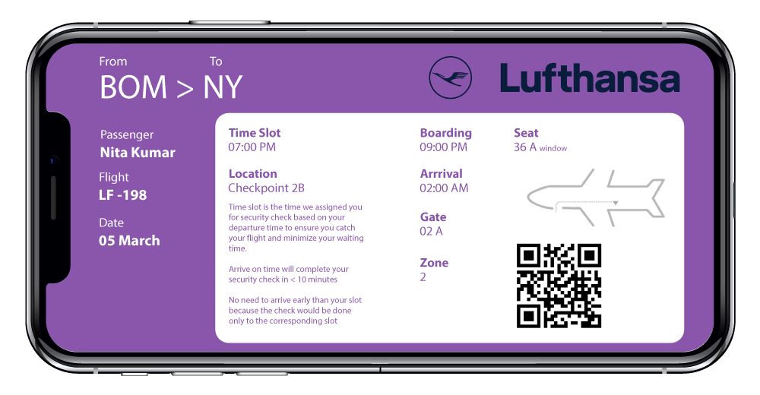
Cloud Walk
Boarding Pass
Is a mobile app, live help for flyer

Slide 17
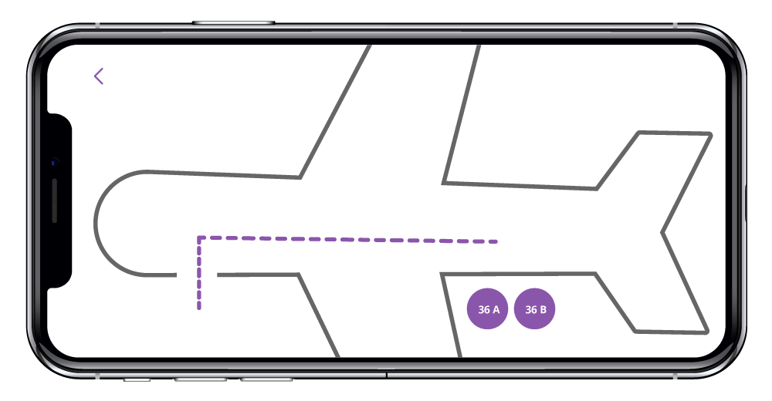
Cloud Walk
The Summary (Conclude)
Is a mobile app, live help for flyer
Nita will continue to follow advise from CloudWalk and will reach her destination peacefully
She would have utilized her time optimally
She can continue to relax near the boarding gate whilst spending time with her child till the gates open
CloudWalk will inform Nita once the gate opens and will direct Nita to the exact seat

Slide 18
Thank you
amit.bhopi@gmail.com
98208 34541
Notes:
Note: Please after inserting your picture, “Right Click” on the picture and “Send it to Back” to get the “Gradient” effect.

